Slide 1

arm
azure resource manager

Slide 2

wot?

Slide 3
wot?
azure resource manager
resource groups
resource providers
management api
Notes:
Azure resource manager –
Resource providers -
Management api -
Resource groups – logical groupings of resources in azure

Slide 4
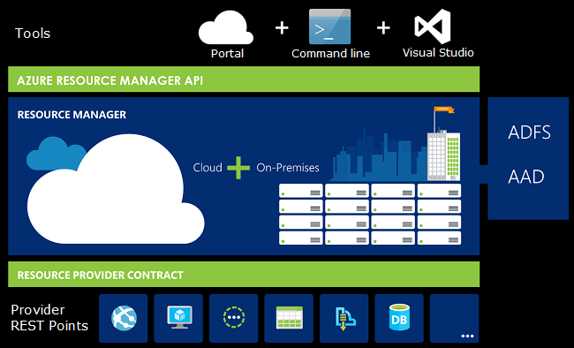
wot?
Notes:
Azure has a resource manager

Slide 5
wot?
ARM != ARM Templates

Slide 6
templates
declarative description of resources
deployed to resource groups
deployed through resource manager
written in json
Notes:
Declarative description of resources
Deployed to resource groups
Deployed to the resource manager
Written in json

Slide 7

do I really need this?
infrastructure as code
devops
automation
repeatable
cattle not pets
idemponent
Notes:
Infra as code – same rigur as your code. It can be versioned with your code. Branched with you code. You know you environment will be deployed into a known state.
Devops – it adopting a devops mindset. Not throwing over the fence infra. Devs are in control.
Automation – by adopting an automation first mindset everything we need can be provisioned in
Repeatable -
Cattle not pets –pets we love and care for and nurse them back to health when they are sick. Cattle we remove and replace when they are sick. Cloud make this easy
Idemponent – same deployment can be repeated over and over with same result

Slide 8
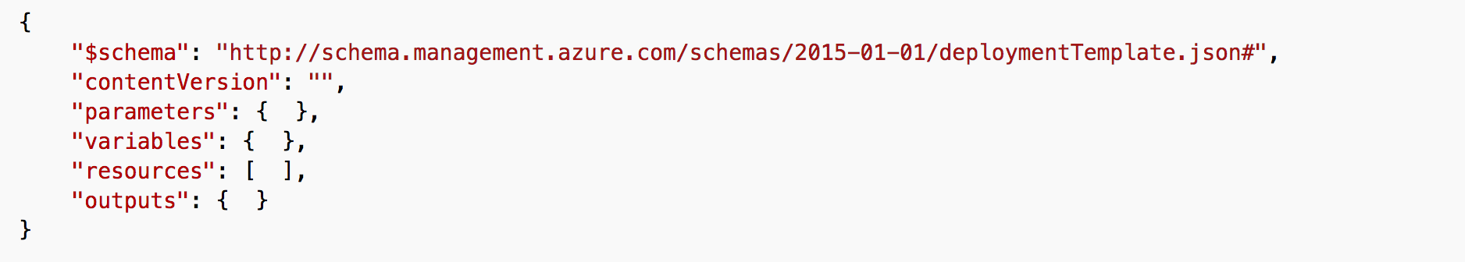
structure
parameters
variables
resources
output
Notes:
Parameters – inputs into template
Variables –
Resources – the stuff you want
Outputs – the stuff that comes out the other end

Slide 9
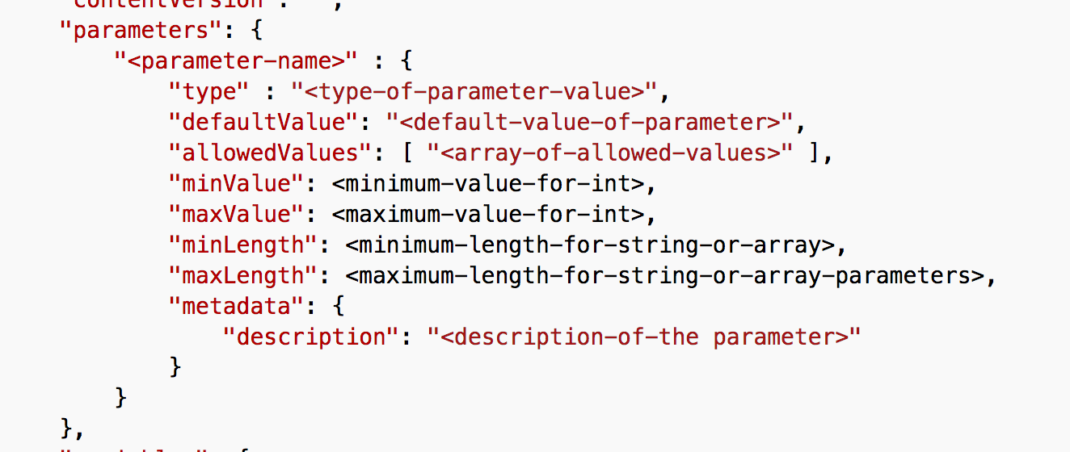
parameters
Parameter types
string, secureString, int, bool, object, secureObject and array
Notes:
Inputs into the ARM template.
Name
Type – list of types
Default value if you don’t specify a parameter will default to this
Constraints on the inputs
Metadata just a description of the parameter will show up in the portal when deploying the template.

Slide 10
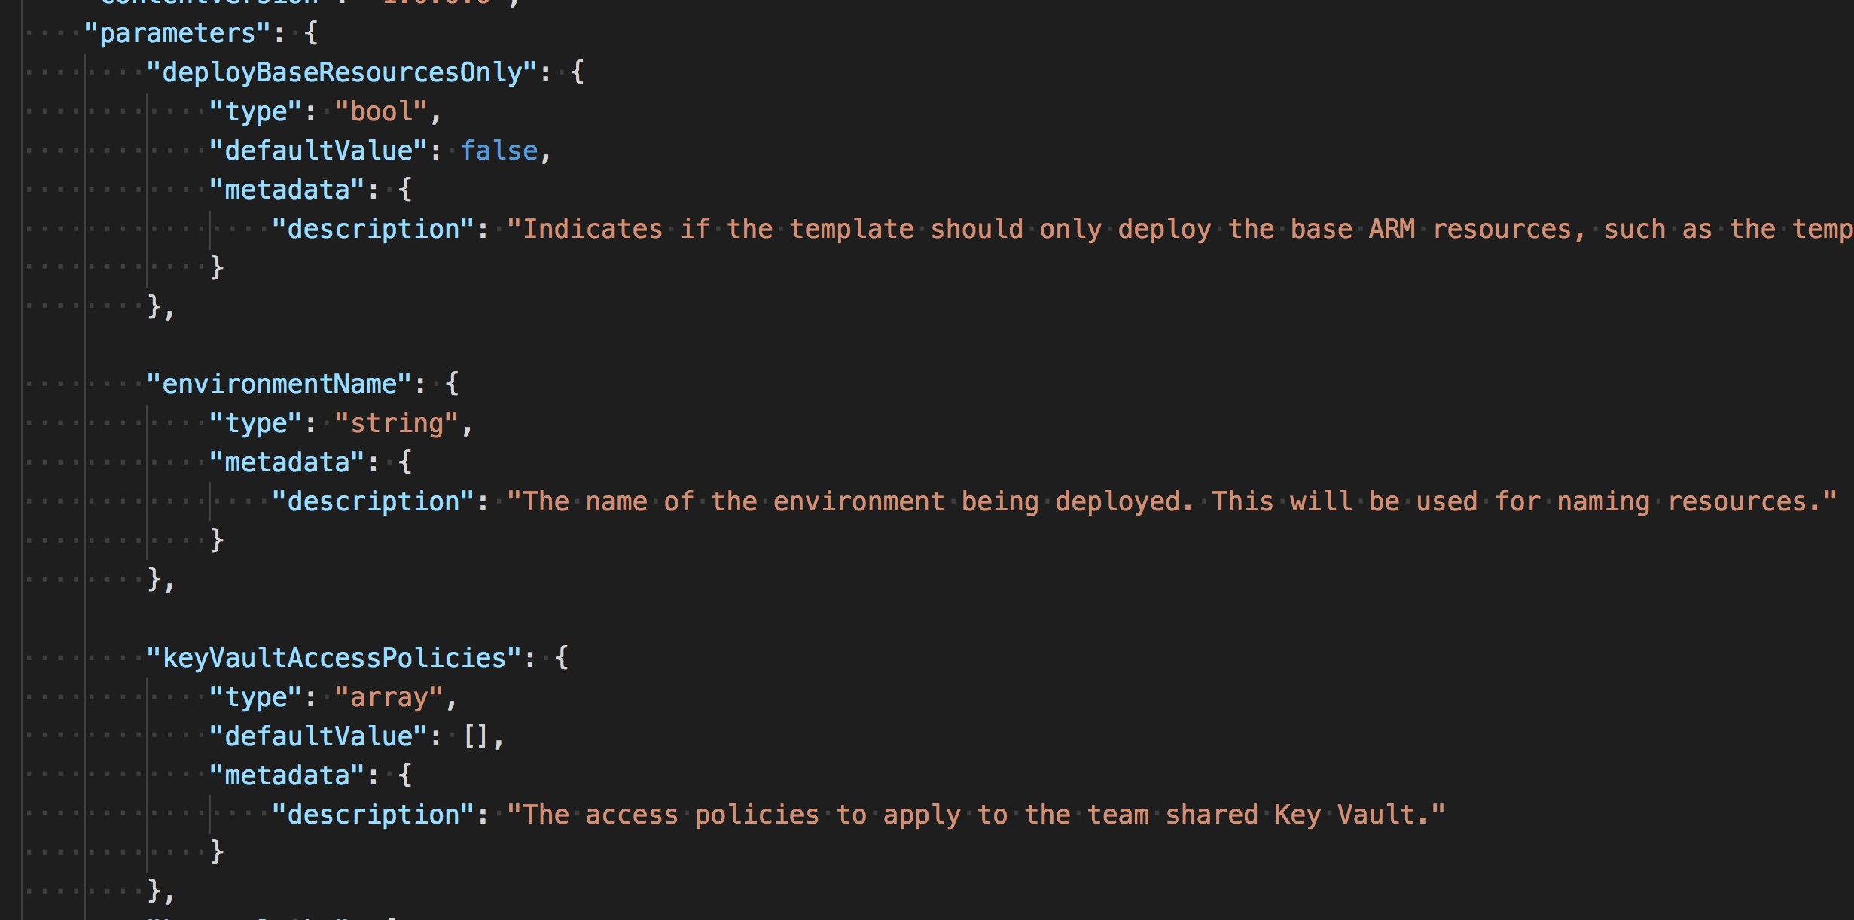
parameters
Notes:
Snapshot from platform
Bool for a condition check
The Environment name used to provision and append names
List of access policies for a key vault.
Can have a default value.

Slide 11
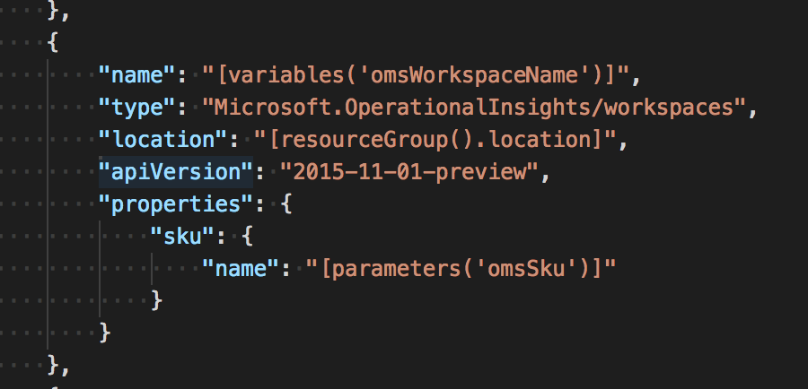
parameters
referencing parameters
parameters(“parameterName”)
”name”: ”[parameters(“parameterName”)]”
Notes:
Reference in the arm template using the parameters function

Slide 12
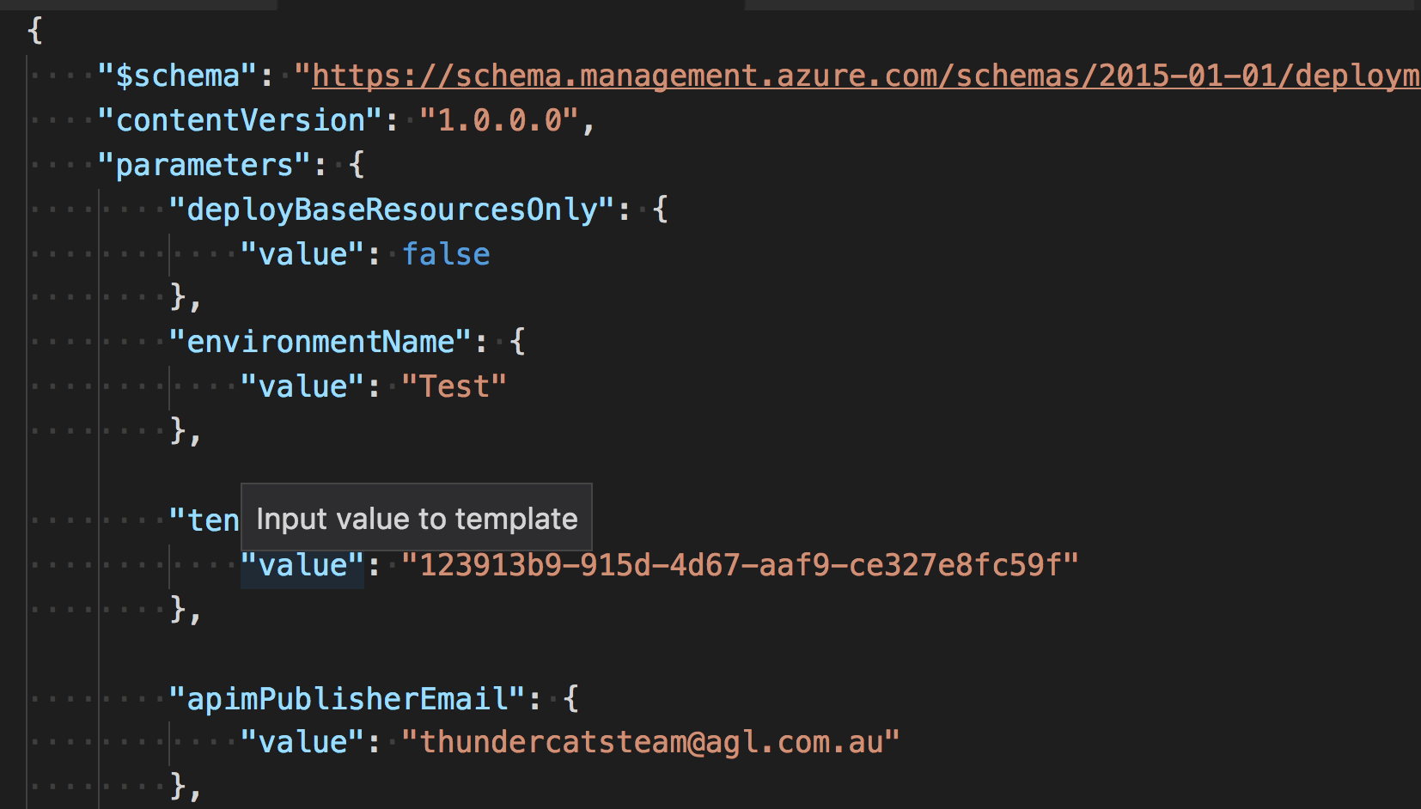
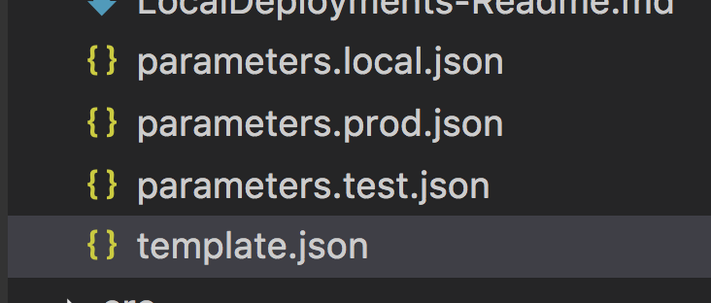
parameters file
Notes:
Used for environments
Specify set the required parameters for a deployment like the environment name
Passed along with the templates

Slide 13
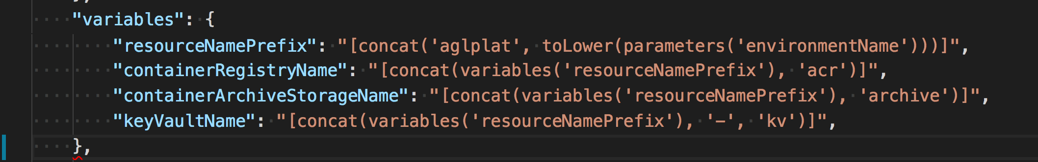
variables
Assigning variables
Referencing variables
“name”: ”[variables(‘variableName’)]”
Notes:
Varibles are evaluated at the deployment time.
Referenced through the template using variables function
We use this to ensure naming is consistent throught the template. And if it needs to change we just change it one spot.

Slide 14
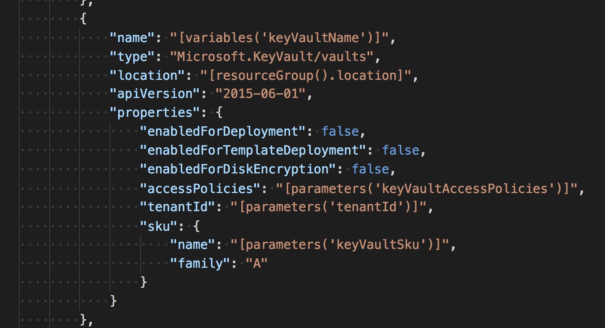
resources
Notes:
Name – the name of the resource
Type – the Resource type. Which Provider will be called to do the deployment
Location – the Data center where you want the resource provisioned
Api version – the version of the management Api needed to provision the resource
Properties – Specfic configuration values for the resource

Slide 15

depends on
Web App
Application Insights
Notes:
Talk about the dependencies chain when deploying resources
Example web app requires Instrumentation Key for application insights. Instrumentation key is only available after the application insights has been provisioned

Slide 16
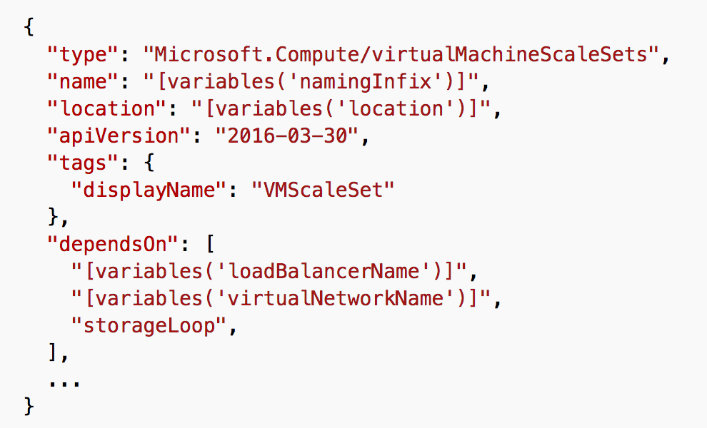
depends on
Notes:
Resources can have a dependencies.
They can have a sequence which they are required to be deployed.
Specify which resource it depends on and ARM takes care of the sequence.

Slide 17
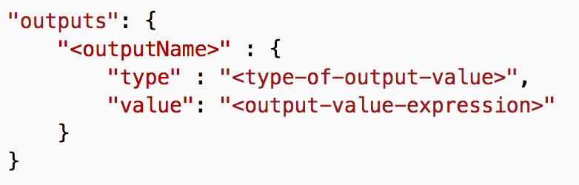
outputs
Notes:
The output name. Name of the output object
The type – same as the parameters types
Value – output value can reference anything in the arm template. Things like getting keys or names or urls out after they are created

Slide 18
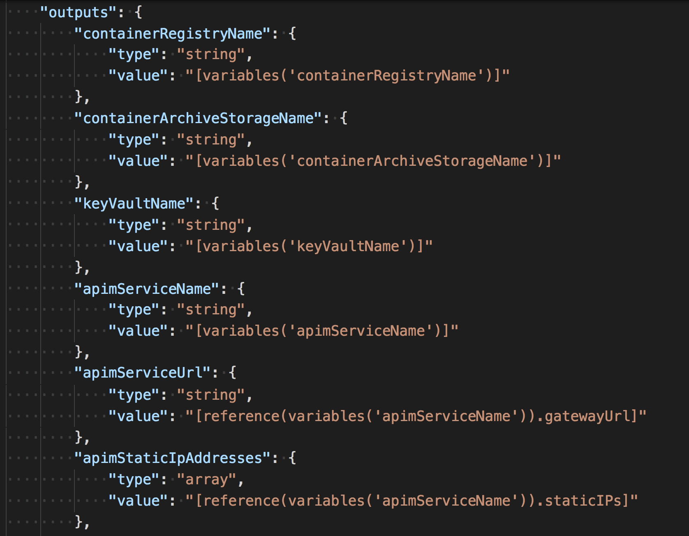
outputs
Notes:
Output information that is needed for flow on processing

Slide 19
functions
Square brackets
[ ]
“property”: “[“concat(‘value1’, ‘value2’)”]”
usage
https://docs.microsoft.com/en-us/azure/azure-resource-manager/resource-group-template-functions
Notes:
Template functions
Expressions run during deployments
Square bracket notation
String but can evaluate to objects

Slide 20
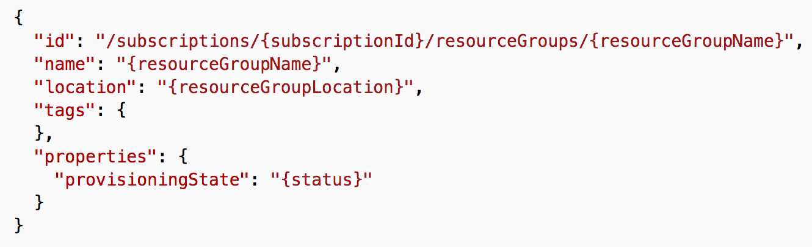
functions
resourceGroup()
Returns
usage
https://docs.microsoft.com/en-us/azure/azure-resource-manager/resource-group-template-functions
Notes:
Returns a resource group object that contains information about the resource group that the template is being deployed to

Slide 21
functions
concat
Usage
concat(arg1, arg2, arg3, ...)
https://docs.microsoft.com/en-us/azure/azure-resource-manager/resource-group-template-functions-array#concat
Notes:
Concatenates values together and returns a string.

Slide 22
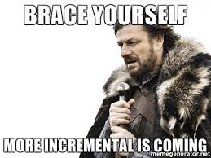
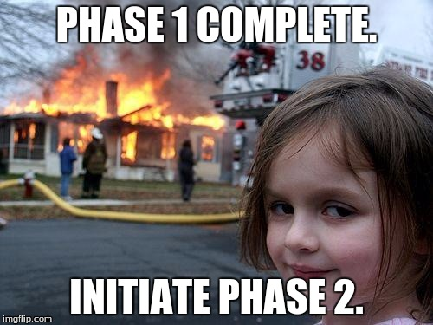
deployment mode
incremental
complete
Notes:
2 modes of deployment
Incremental – doesn’t delete or remove resources that don’t exist
Complete – does delete resources that don’t exists

Slide 23
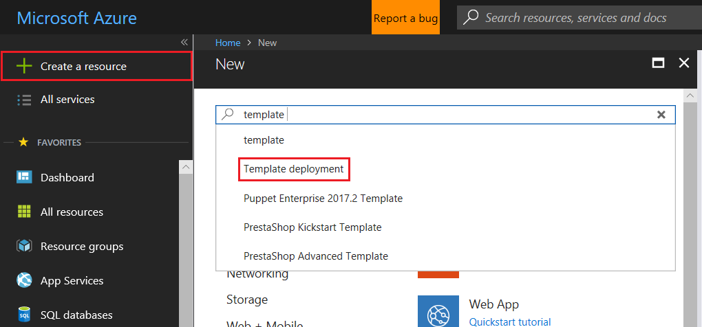
deployment
portal
https://docs.microsoft.com/en-us/azure/azure-resource-manager/resource-group-template-deploy-portal
Notes:
Run demo of portal deployment

Slide 24
deployment
Login-AzureRmAccount
Select-AzureRmSubscription -SubscriptionName <yourSubscriptionName>
New-AzureRmResourceGroup -Name ExampleResourceGroup -Location ”Australia Southeast”
New-AzureRmResourceGroupDeployment -Name ExampleDeployment -ResourceGroupName ExampleResourceGroup ` -TemplateFile c:\MyTemplates\storage.json -storageAccountType Standard_GRS
powershell
https://docs.microsoft.com/en-us/azure/azure-resource-manager/resource-group-template-deploy
Notes:
Run demo of powershell arm deployment
Login – using Login-AzureRmAccount
Subscription - Select-AzureRmSubscription
Create a resource group to deploy to New-AzureRmResourceGroup
New-AzureRmResourceGroupDeployment to run a deloyment

Slide 25
deployment
az login
az group create --name ExampleGroup --location ”Australia Southeast”
az group deployment create \
--name ExampleDeployment \
--resource-group ExampleGroup \
--template-file storage.json \
--parameters storageAccountType=Standard_GRS
azure cli
https://docs.microsoft.com/en-us/azure/azure-resource-manager/resource-group-template-deploy-cli
Notes:
Python tools for managing azure
Run demo of az group deployment

Slide 26
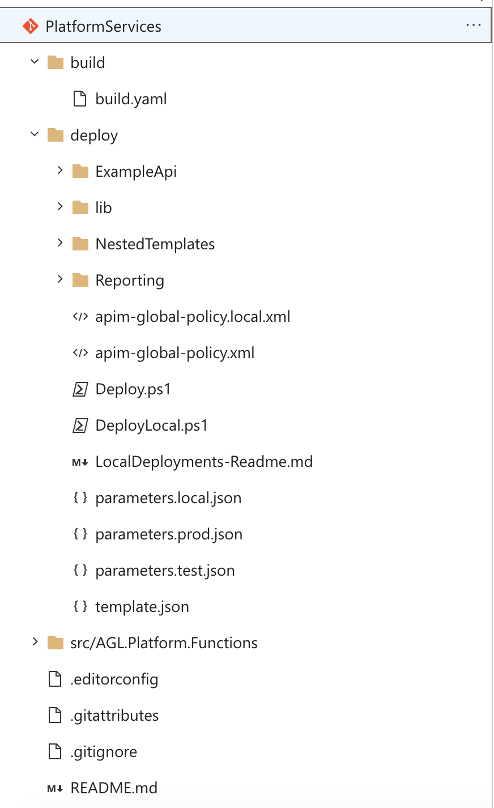

repository
+-- build
| +-- build.yaml
+-- deploy
| +-- template.json
| +-- parameter.prod.json
| +-- parameters.test.json
| +-- Deploy.ps1
+-- src
| +-- your super cool code
+-- readme.md
Notes:
3 folders
One build containing our build.yaml. Which is the definition of our build
Deploy folder – which contains our infrastructure as code
Src and our source code to deployed
One descreet package. Once source of truth. One nugget

Slide 27
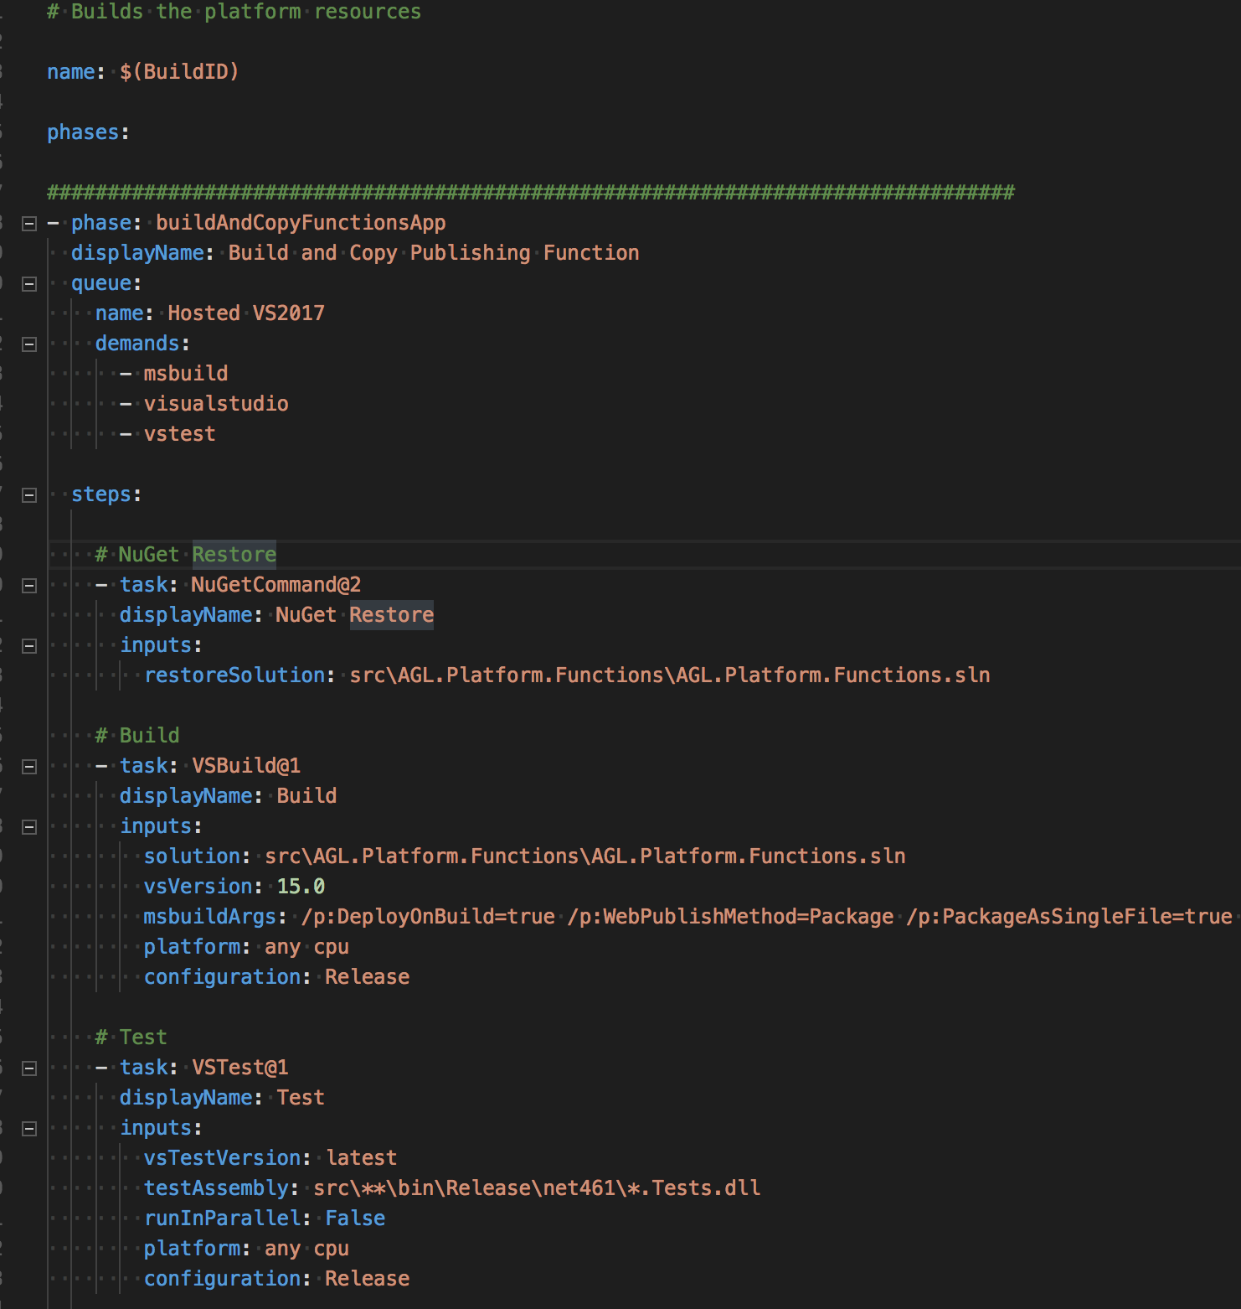
VSTS
build.yaml
https://blog.kloud.com.au/2017/11/26/vsts-build-definitions-as-yaml-part-1-what-and-why/
https://blog.kloud.com.au/2017/11/26/vsts-build-definitions-as-yaml-part-2-how/

Slide 28
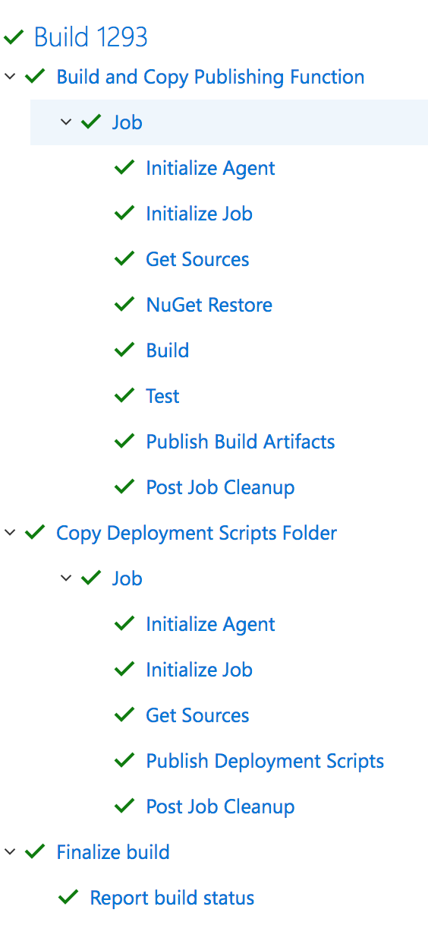
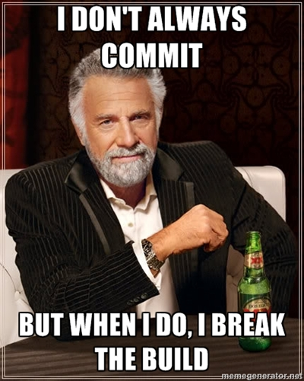
VSTS
builds
Notes:
Uses build yaml
Restores dependencies
Compiles codes
Runs tests
Publish artifacts

Slide 29
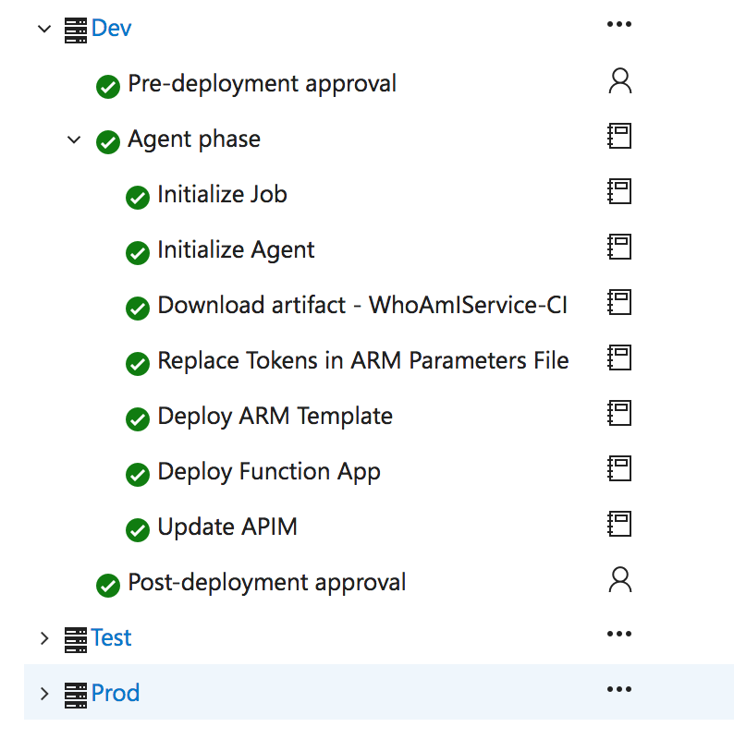
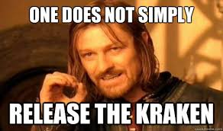
VSTS
releases
Notes:
Gets artifacts from build
Replaces token in require files
Deploy the appropriate arm template
Deploy the code
Update the api platform - build produces swagger and apim polcies and publish to platform

Slide 30
resources
Github samples repo
https://azure.microsoft.com/en-us/resources/templates/
Arm schema repo
https://github.com/Azure/azure-resource-manager-schemas
Resource manager**
https://resources.azure.com/
Automation script**
Notes:
GitHub repository – sample getting start and a some more complex templates. I find this is the best resource.
Arm Schema - the Schema of all the apis versions. Can be helpful to see whats missing or required. Not every api version is here.
Resource manager – demo resource manager
Extra noise that isn’t required like provising state etc
Doesn't always match the arm template schema
Automation script
Automation script parametizers everything
Sometimes things don’t show up if they are not support by arm

Slide 31
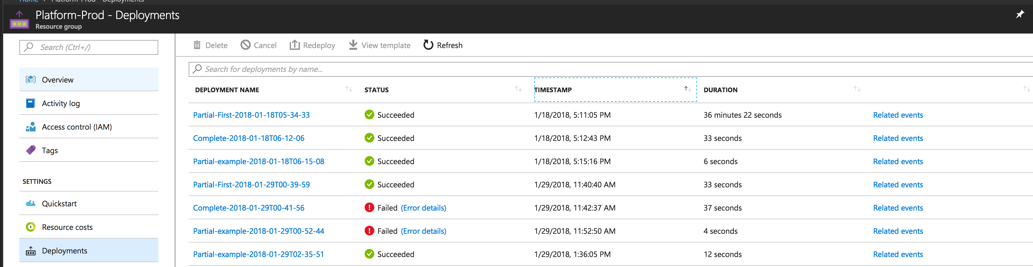
diagnostics
deployments
Notes:
Log into portal.
Demo the Deployments in resource group deployments
Open he Arm Template up and edit
Show the Activity Log

Slide 32
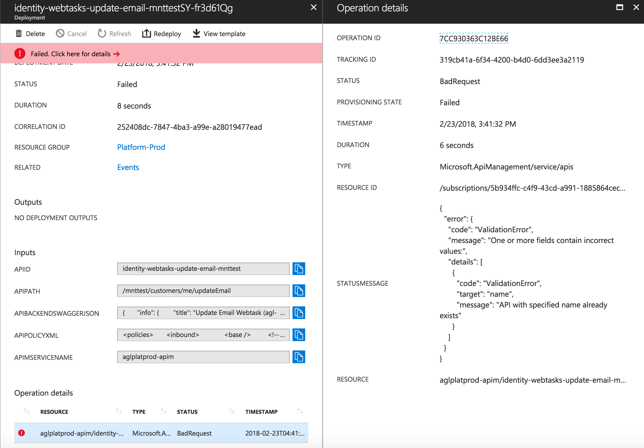
diagnostics
deployments
Notes:
Log into the portal show a deployment and open the deployment drill down a bit into more details
Show the resources being provisioned.

Slide 33
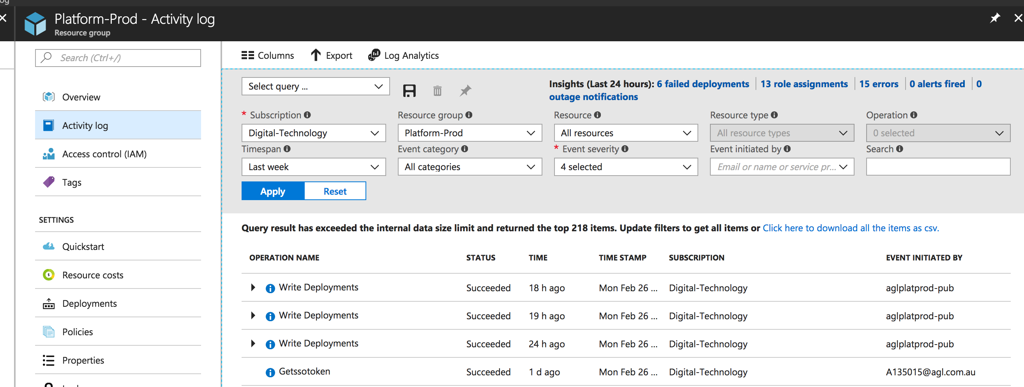
diagnostics
activity logs
Notes:
Log into portal.
Show the Activity Log

Slide 34

TL;DR;
Azure Resource Manager
Templates
Infrastructure as Code
VSTS
Notes:
Log into portal.
Demo the Deployments in resource group deployments
Open he Arm Template up and edit
Show the Activity Log

Slide 35
references
Getting Started
https://docs.microsoft.com/en-us/azure/azure-resource-manager/resource-group-authoring-templates
https://docs.microsoft.com/en-us/azure/azure-resource-manager/resource-manager-create-first-template
Infrastructure as Code
https://blogs.msdn.microsoft.com/mvpawardprogram/2018/02/13/infrastructure-as-code/
Build YAML
https://blog.kloud.com.au/2017/11/26/vsts-build-definitions-as-yaml-part-1-what-and-why/
https://blog.kloud.com.au/2017/11/26/vsts-build-definitions-as-yaml-part-2-how/
Deployments
https://docs.microsoft.com/en-us/azure/azure-resource-manager/resource-group-template-deploy-portal
https://docs.microsoft.com/en-us/azure/azure-resource-manager/resource-group-template-deploy
https://docs.microsoft.com/en-us/azure/azure-resource-manager/resource-group-template-deploy-cli
Azure PowerShell
https://docs.microsoft.com/en-us/powershell/azure/install-azurerm-ps?view=azurermps-5.3.0
Azure CLI
https://docs.microsoft.com/en-us/cli/azure/install-azure-cli?view=azure-cli-latest

Slide 36
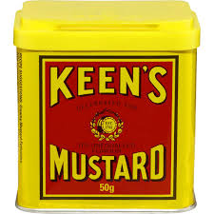
keen as?
We are open to doing more advanced arm topics or other topics
Notes:
Log into portal.
Demo the Deployments in resource group deployments
Open he Arm Template up and edit
Show the Activity Log

Slide 37

questions?
#ask-thundercats
come say hello on level 11
Notes:
Log into portal.
Demo the Deployments in resource group deployments
Open he Arm Template up and edit
Show the Activity Log

